Slide 1


Concepts
in Digital Literary Studies
Bootcamp
MA Digital Text Analysis
Wout Dillen

Slide 2
Digital Literary Studies
General Introductions:
Digital Humanities
Model(l)ing
Qualitative Approach
Digital Scholarly Editing
Quantitative Approaches
Distant Reading
Text Reuse
Stylometry
Topic Modelling

Slide 3
General Introductions

Slide 4
Digital Humanities

Slide 5
What is Digital Humanities?
What do you think of when you hear the words: Digital Humanities?

Slide 6
What is Digital Humanities?
Day of DH
(https://dhcenternet.org/initiatives/day-of-dh/)
A Day in the Life of the Digital Humanities (Day of DH) is an open community publication project that will bring together scholars interested in the digital humanities from around the world to document what they do on one day.
(DayofDH2015: About)
See also: https://whatisdigitalhumanities.com
And the twitterbot @DHDefined: https://twitter.com/DHDefined

Slide 7
What is Digital Humanities?
Exercise:
Surf to whatisdigitalhumanities.com and randomly read some of the definitions on there, refreshing the page to move on to the next one. If you find particularly good, funny, or bad definitions, note them down. We’ll discuss what you found and how you experienced them in class afterwards.
Are there any patterns you discover in your reading? Things that keep coming back? Things that a lot of people seem to find important? Or difficult?

Slide 8
What is Digital Humanities?
Some interesting examples:
DH is the use of digital resources to mediate what it means to be human.
Lisa Rhody (2012)
Taking people to bits.
Graeme Earl (2012)
Ultimately, what sets DH apart from many other humanities fields is its methodological commitment to building things as a way of knowing.
Brad Brace (2011)
Troubleshooting, troubleshooting, troubleshooting.
Hillary (2014)
Digital humanities is quilt making.
Dean Rehberger (2014)

Slide 9
What is Digital Humanities?
DH as a Community of Practice
A 'community of practice' (to borrow Etienne Wenger's phrase) whereby the learning, construction and sharing of humanities knowledge is undertaken with the application of digital technologies in a reflexive, theoretically-informed, and collaborative manner. (Kathryn E. Piquette, 2011)
DH is more a community of practice than a specific set of methods and procedures. (James Ginther, 2011)
A community of practice using and critiquing digital tools to further humanities study. (Amanda French, 2012)
A community of practice involving anyone who engages with humanities subject areas through critical, reflexive and collaborative development and use of digital technologies. (Kathryn E. Piquette, 2012)
A community of practice working at the intersection of technology and the humanities, including hackers, yackers, academia and the public. (Dave Lester, 2012)
A community of practice for humanists who are (1) inventing a new medium of scholarly and educational discourse by exploiting the powerful affordances of the digital medium and (2) critically reflecting upon the process of media innovation. (Janet H. Murray, 2012)
A community of practice who foregrounds the reflexive and theoretically-informed application of digital techniques to humanities subject matter. (Kathryn E. Piquette, 2014)

Slide 10



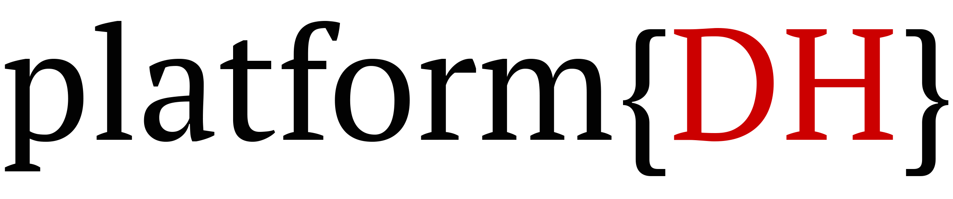



Literature
Linguistics
History
Library

Slide 11
#shamelessPlugs
DHt the UAntwerp | What do we do?
Projects | Training | Talks
https://platformdh.uantwerpen.be

Slide 12
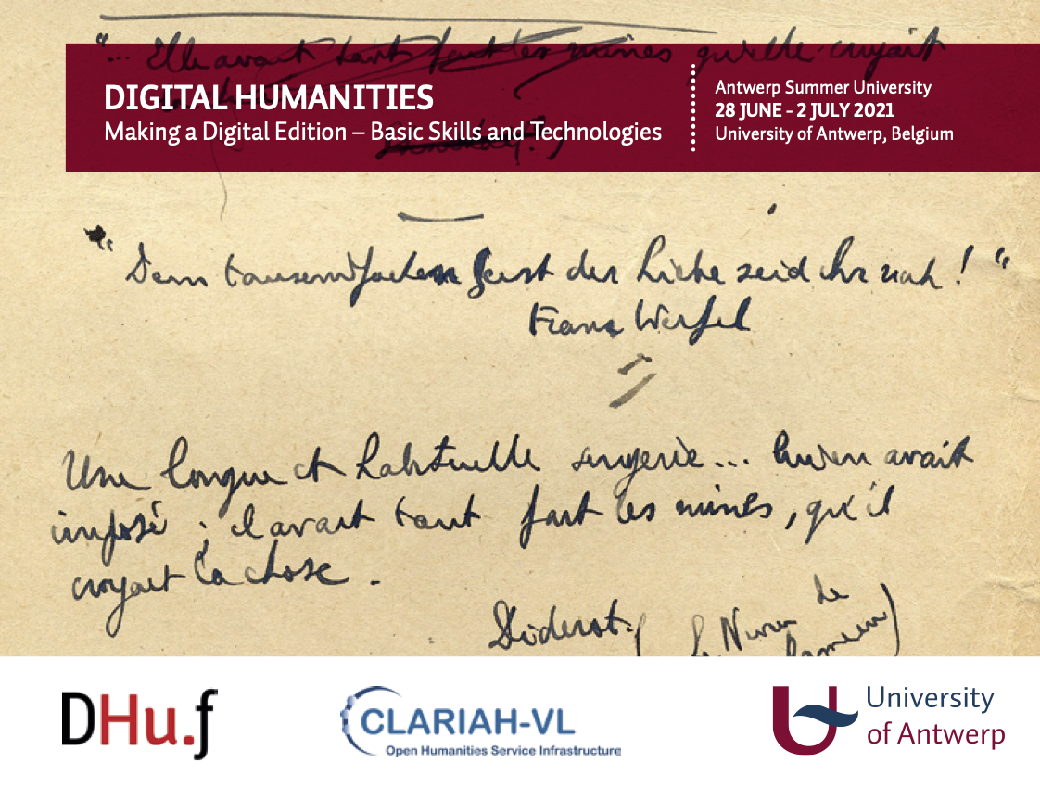
https://www.uantwerpen.be/en/summer-schools/digital-humanities/

Slide 13
#shamelessPlugs
Conferences (at UAntwerp):
Children’s Literature and Digital Humanities (22-23 Oct. 2020)
BAAHE 2020: DH in English Language and Literature Studies (17 Dec. 2020)
Virtual Gatherings
DH Virtual Discussion Group for Early Career Researchers in Belgium (UGent and KU Leuven)
Digital Heritage Seminar (Royal Library of Belgium)

Slide 14
Model(l)ing

Slide 15
What is Modelling?
Definitions
By ‘‘modeling’’ I mean the heuristic process of constructing and manipulating models; a ‘‘model’’ I take to be either a representation of something or purposes of study, or a design for realizing something new.
(McCarthy 2004, 255)

Slide 16
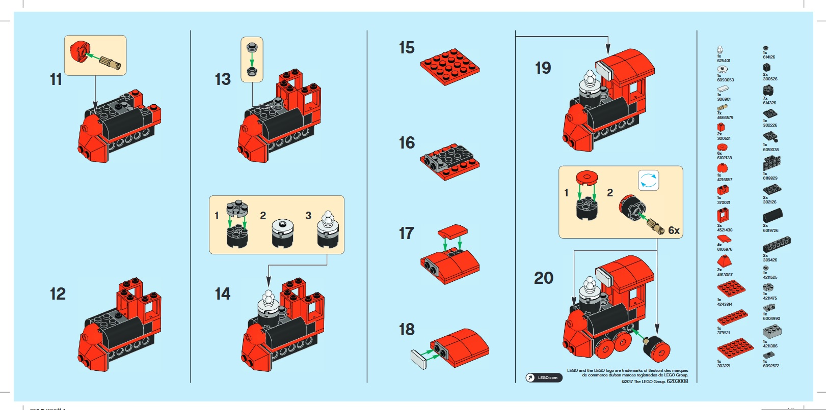
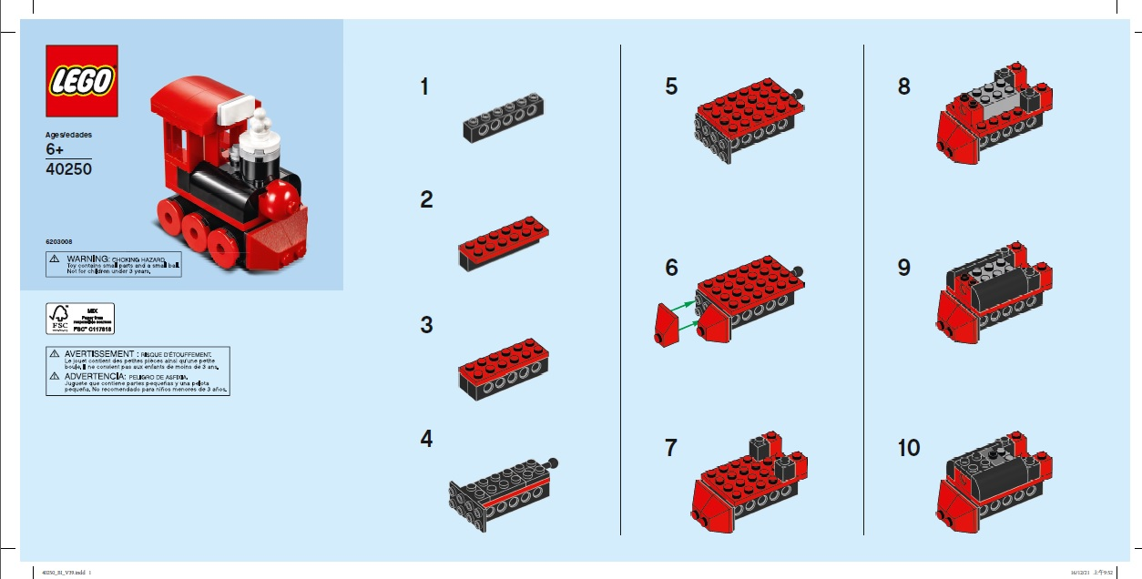
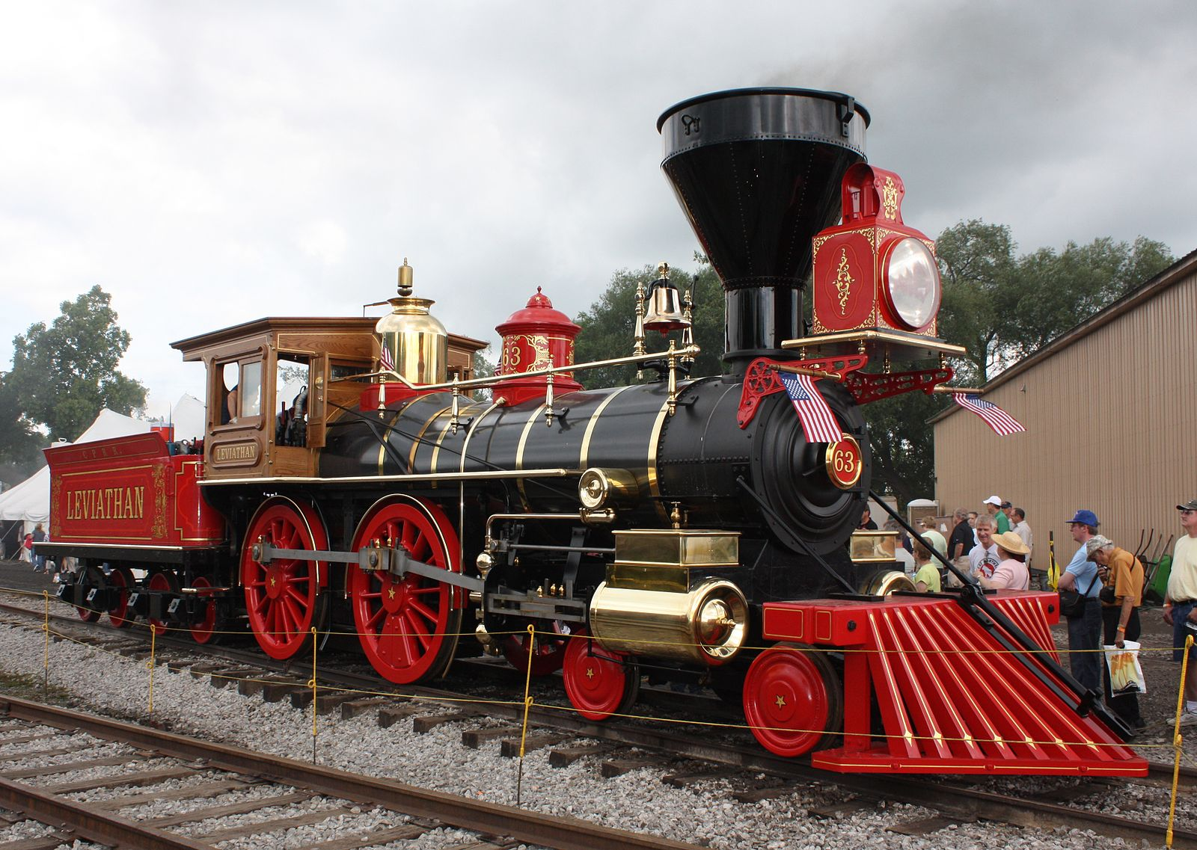
Types of Modelling
Model of
(descriptive)
Model for
(prescriptive)

Slide 17
Examples
Can you come up with any examples of models in traditional humanities research?
Grammars
Periodization in literature
Index at the back in books
Are these models of? Or models for?
Can you think of any digital applications or equivalents for these?
What makes models so useful for research?

Slide 18
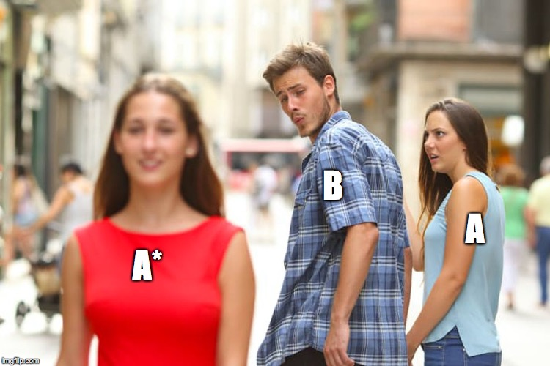
What makes models useful for research?
To an observer B, an object A* is a model of an object A to the extent that
B can use A* to answer questions that interest him about A.
(Minsky 1995)

Slide 19
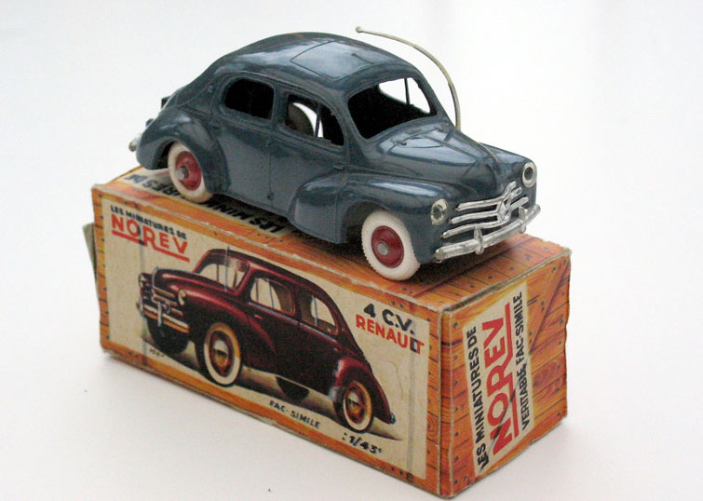
What makes models useful for research?
What kind of questions
can
this model answer?
What kind of questions can’t
this model answer?

Slide 20
Characteristics
What are some characteristics of models?
Simple / Simplification (cf. Occam’s razor: scope vs simplicity)
Computationally tractable
Consistent
Manipulable
Can we distinguish between good and bad models?
“All models are wrong but some are useful” (George Box)
Functional (>< essentialist) perspective; cf. Minsky

Slide 21
Characteristics
What is the difference with the traditional humanities?
Use of computers: greater emphasis, awareness of modelling; more explicit
aims of consistency and scope
Computers, in particular software are themselves models by necessity
Importance of heuristic process (a model is never finished):
temporary states in a process of coming to know
Never-ending cycle of (re)construction and (re)manipulation

Slide 22
Modelling in Practice
Exercise:
Go back to the website of the platform{DH} and have a look at the different projects presented there. Each student gets one project assigned to them. Prepare a short presentation of this project to the rest of the group, that explains:
What the project is about
What is being modelled? How can we interpret this research as a model?
https://platformdh.uantwerpen.be/index.php/projects/

Slide 23
A Qualitative Approach

Slide 24
Digital Scholarly Editing

Slide 25
The Digital Scholarly Edition

Slide 26


Slide 27
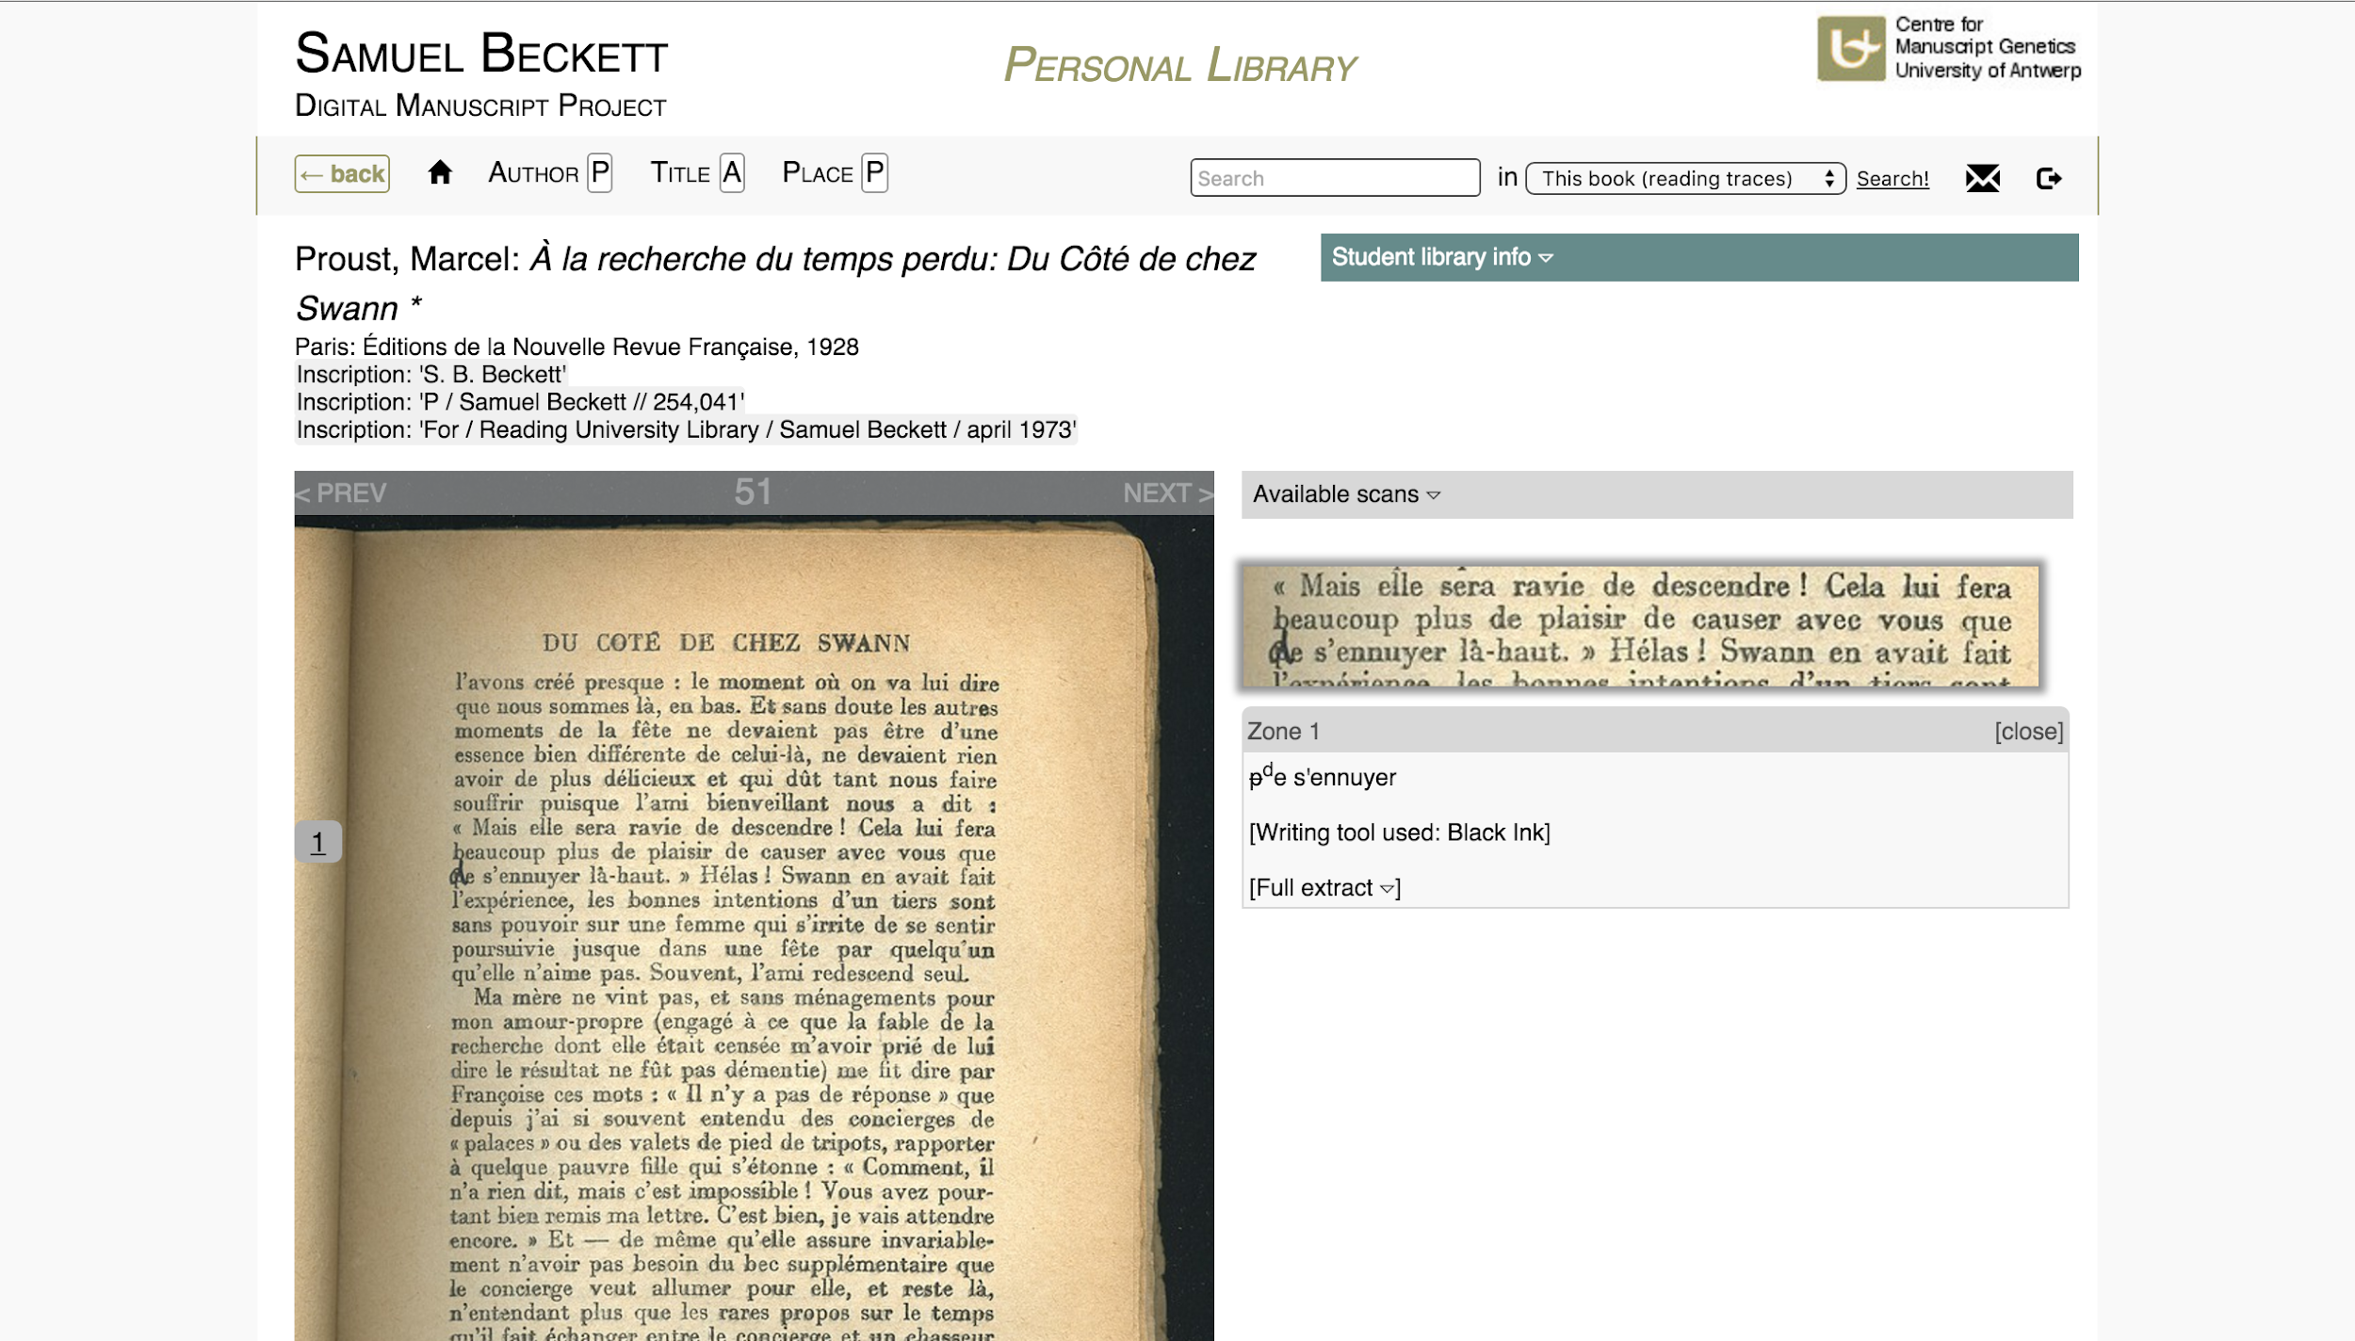

Slide 28
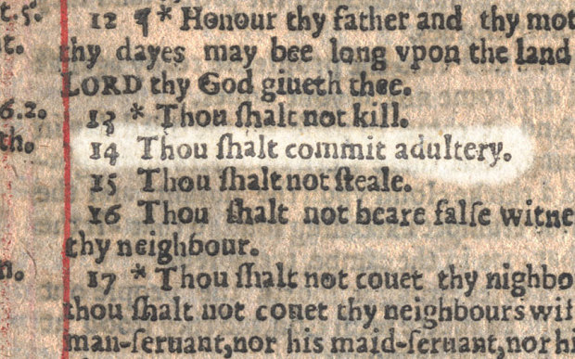
The ‘Wicked Bible’

Slide 29
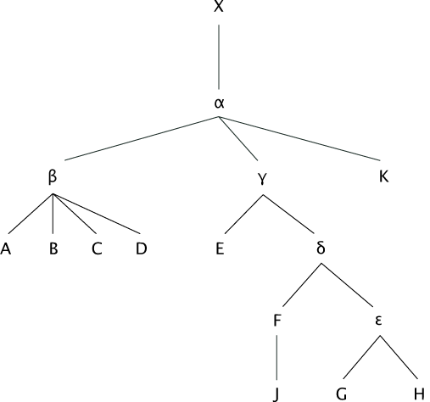

Slide 30
The Digital Scholarly Edition
Textual Criticism:
What is the (closest) authentic text of the work?
How was this text transmitted and transformed over time?
How does this knowledge influence our interpretation of the work?

Slide 31
The ‘Wicked Bible’

Slide 32
The Digital Scholarly Edition
Textual Criticism:
What is the (closest) authentic text of the work?
How was this text transmitted and transformed over time?
How does this knowledge influence our interpretation of the work?
→ Scholarly Edition:
Academic version of the work
Contextualized with research of textual criticism

Slide 33
The Digital Scholarly Edition
Textual Criticism:
What is the (closest) authentic text of the work?
How was this text transmitted and transformed over time?
How does this knowledge influence our interpretation of the work?
→ Scholarly Edition:
Academic version of the work
Contextualized with research of textual criticism

Slide 34
The Digital Scholarly Edition
What is authentic? What do we use as the base text?
The first edition?
The last approved edition?
Are drafts and proofs more or less important than published versions?
What to do with copy-editing?
What to do with the bibliographical aspects of the book?
→ Different ‘schools’ of textual criticism

Slide 35
The Digital Scholarly Edition
German Editionswissenschaft
Document (Historical Critical Edition)
Anglo-American Scholarly Editing
Text (Copy-Text Edition)
French Critique Génétique
Writing Process (Genetic Edition)

Slide 36
Textual Criticism and (Digital) Scholarly Editing
Last decades: rapprochement
Three monolingual discussions become one multilingual one
There is more to Textual Criticism than just these three traditions!

Slide 37


Slide 38
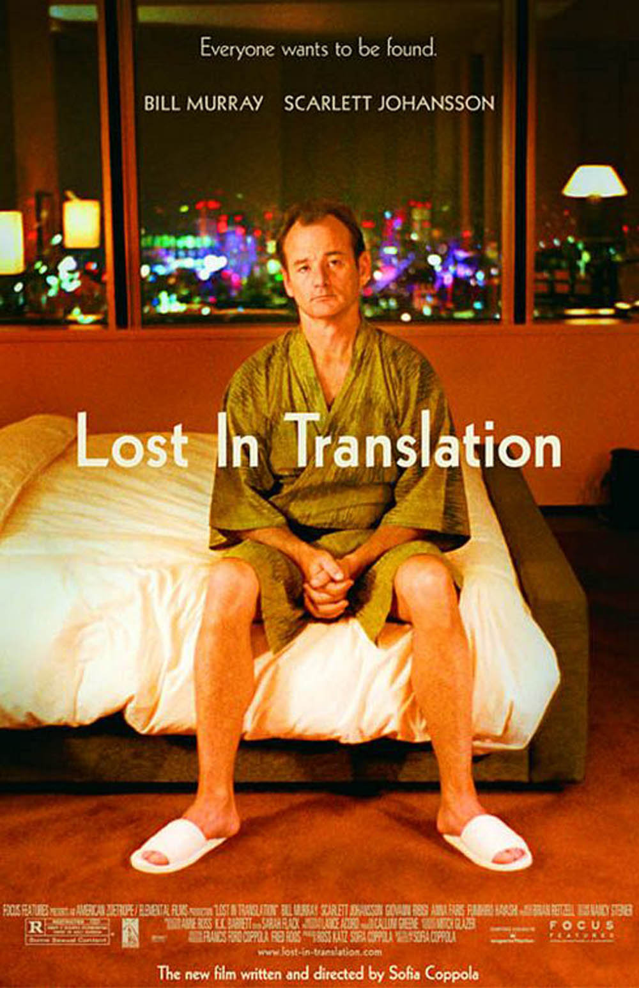

Slide 39
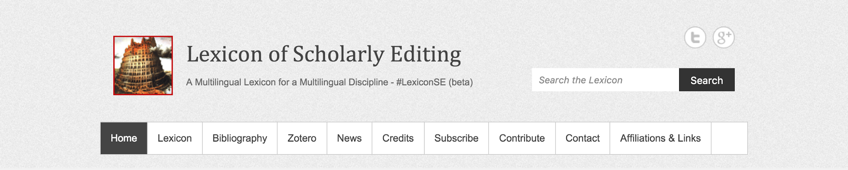

The Digital Scholarly Edition
https://lexiconse.uantwerpen.be
#LexiconSE

Slide 40
The Digital Scholarly Edition
Textual Criticism:
a research field concerned with the way text is transmitted over time, and the way in which this transmission may inform our reading of the text.
Scholarly Edition:
The field’s output format, aiming to represent an authoritative, edited text that takes that process of textual transmission into account in some way or other.

Slide 41
The Digital Scholarly Edition

Slide 42
The Digital Scholarly Edition

Slide 43
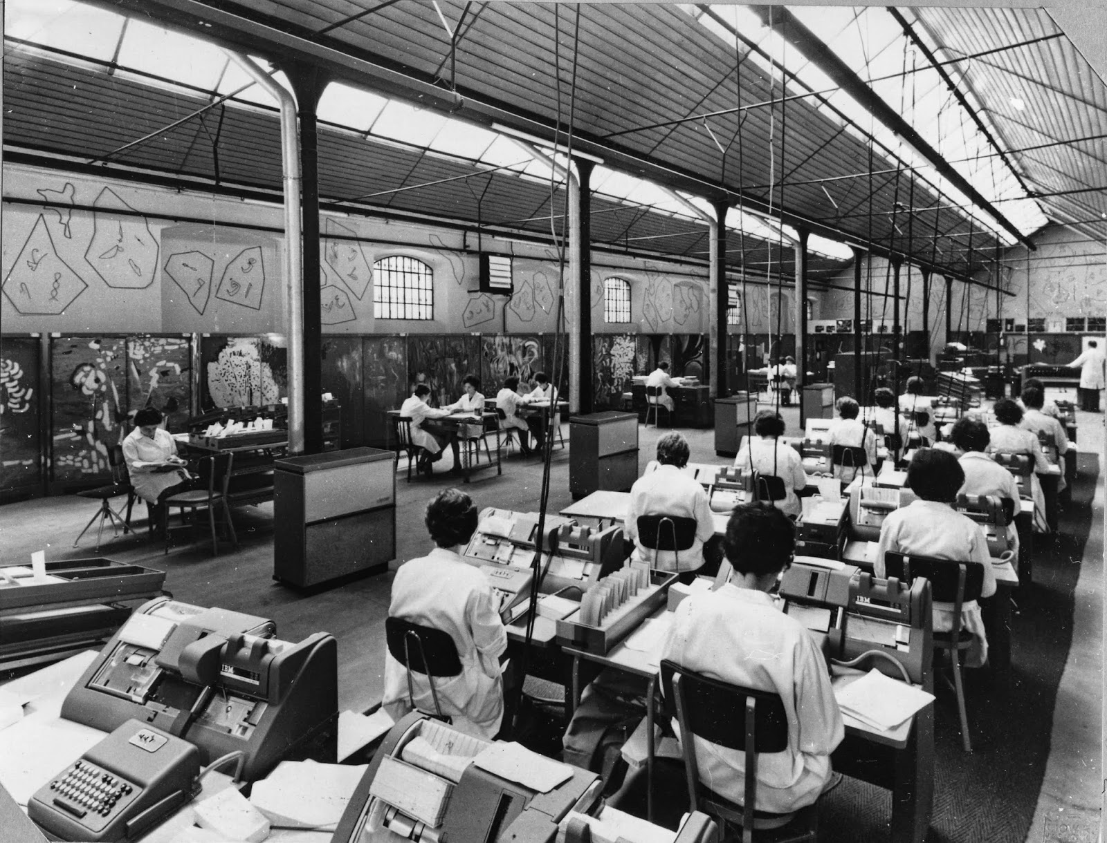
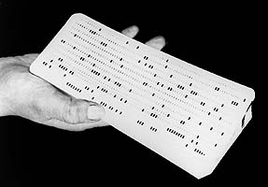
Index
Thomisticus

Slide 44
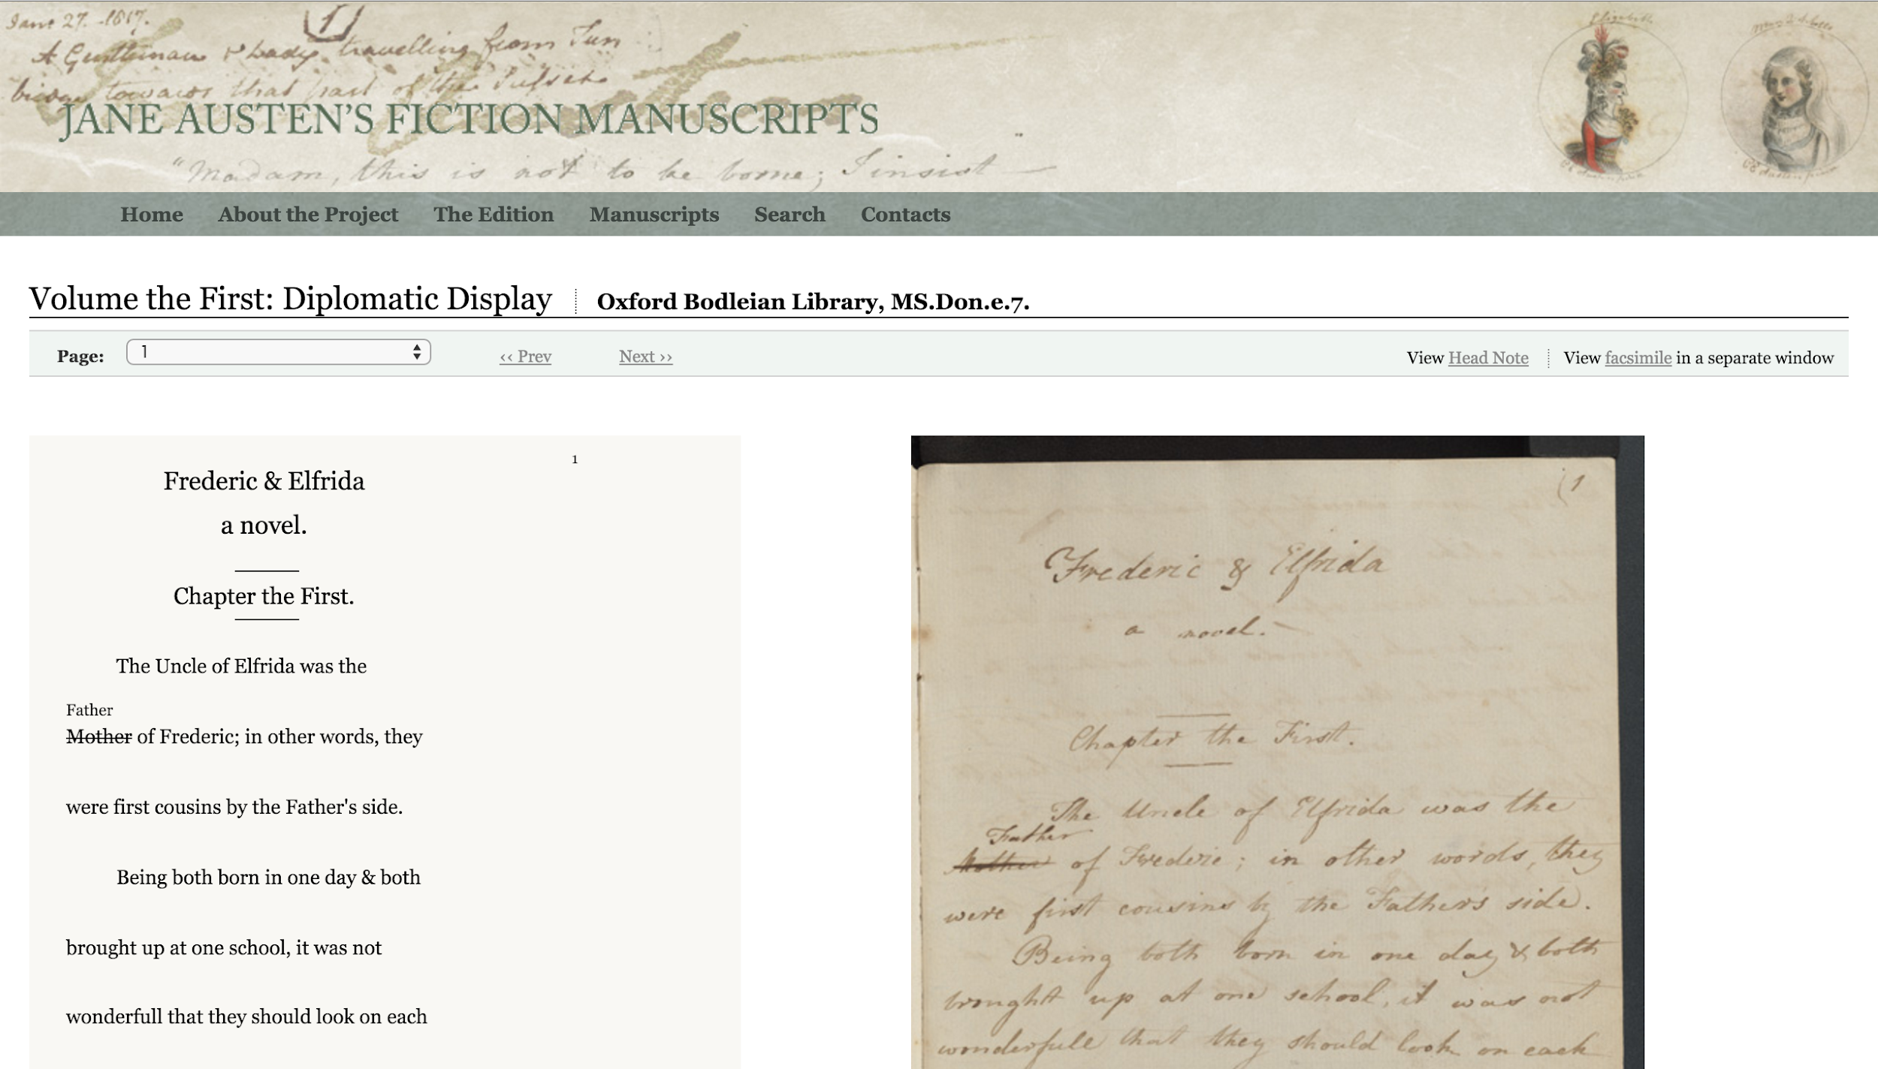
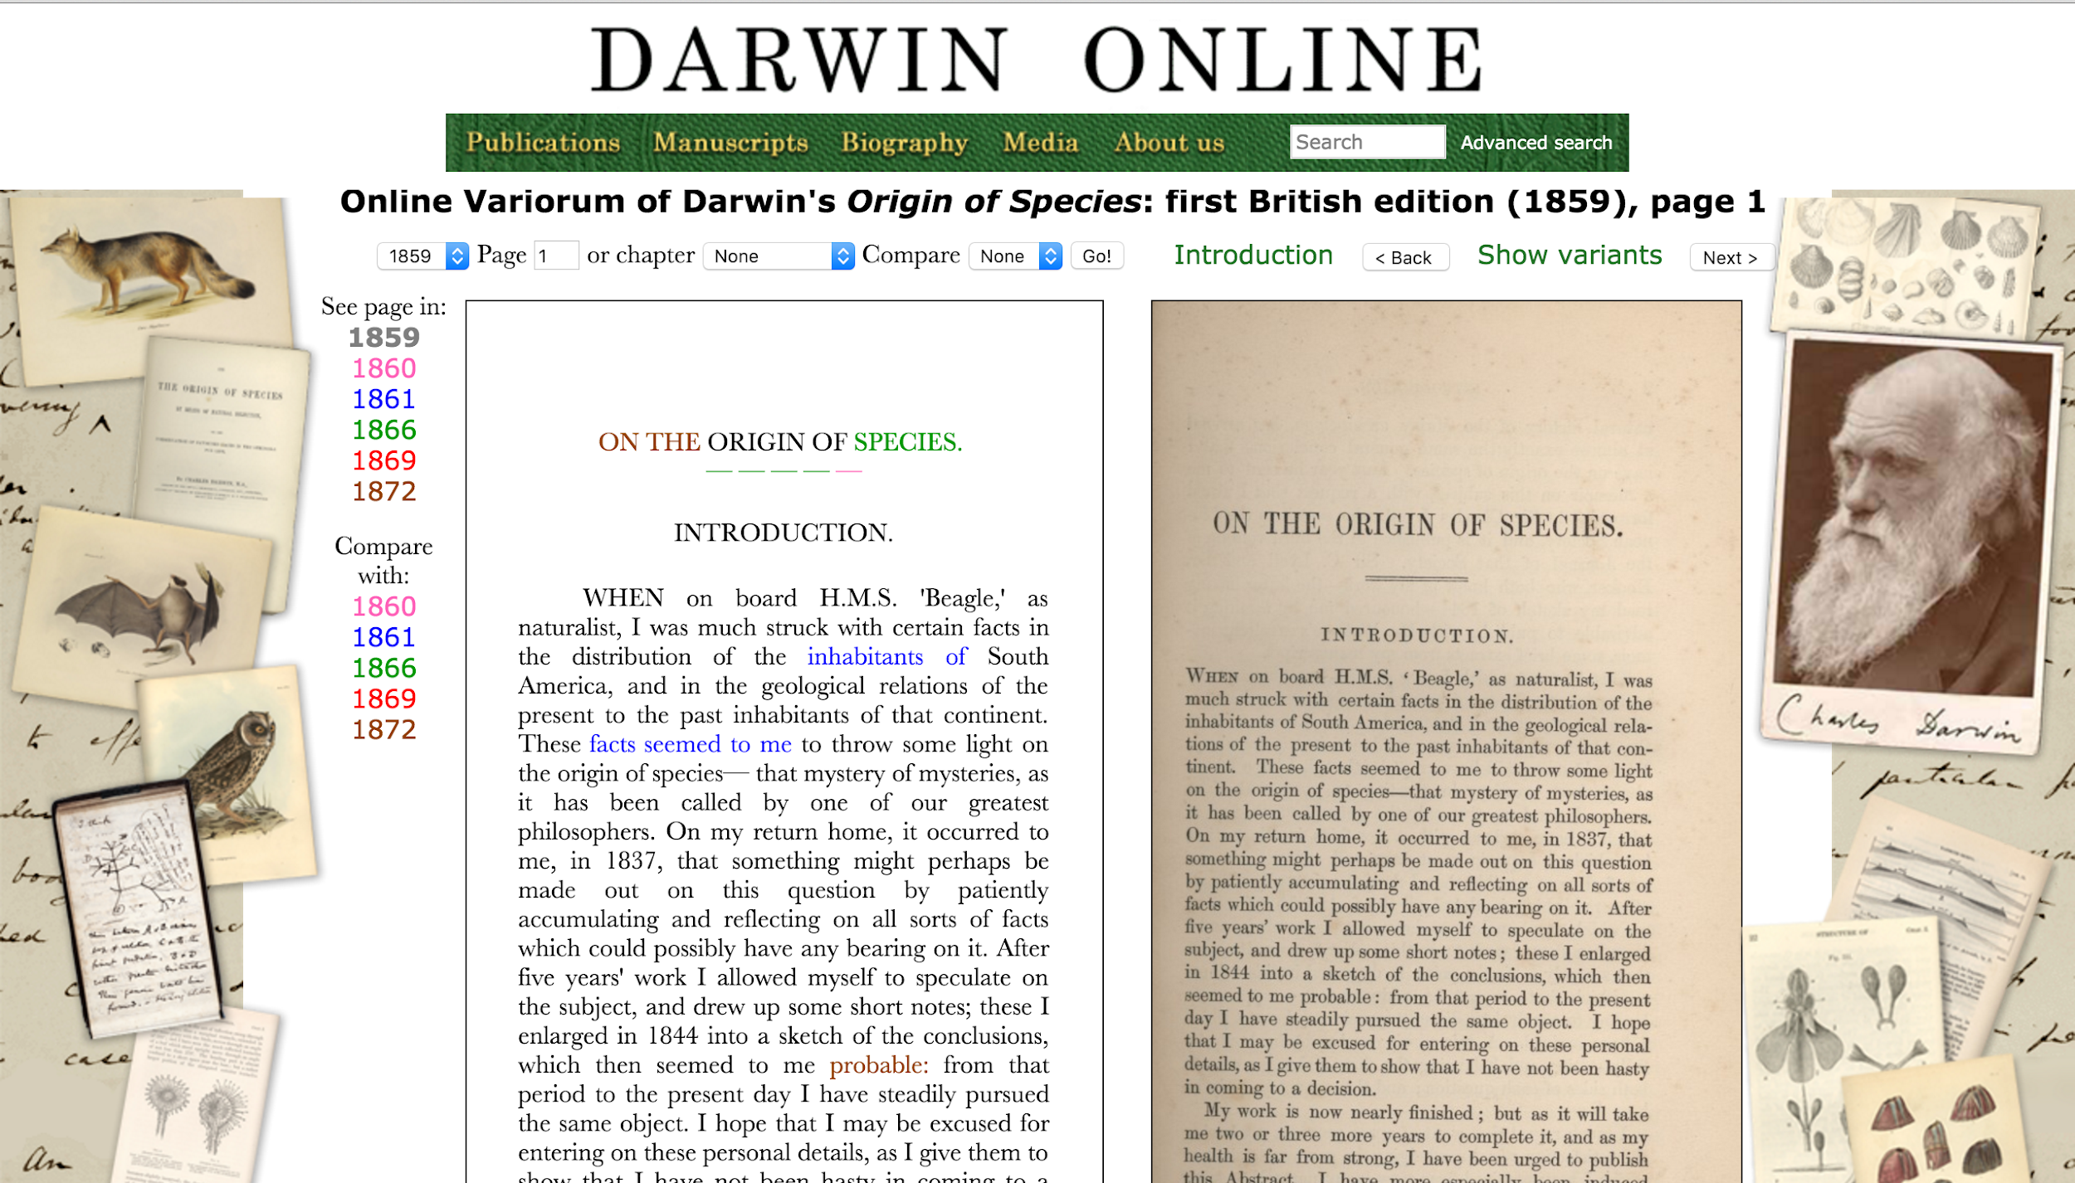
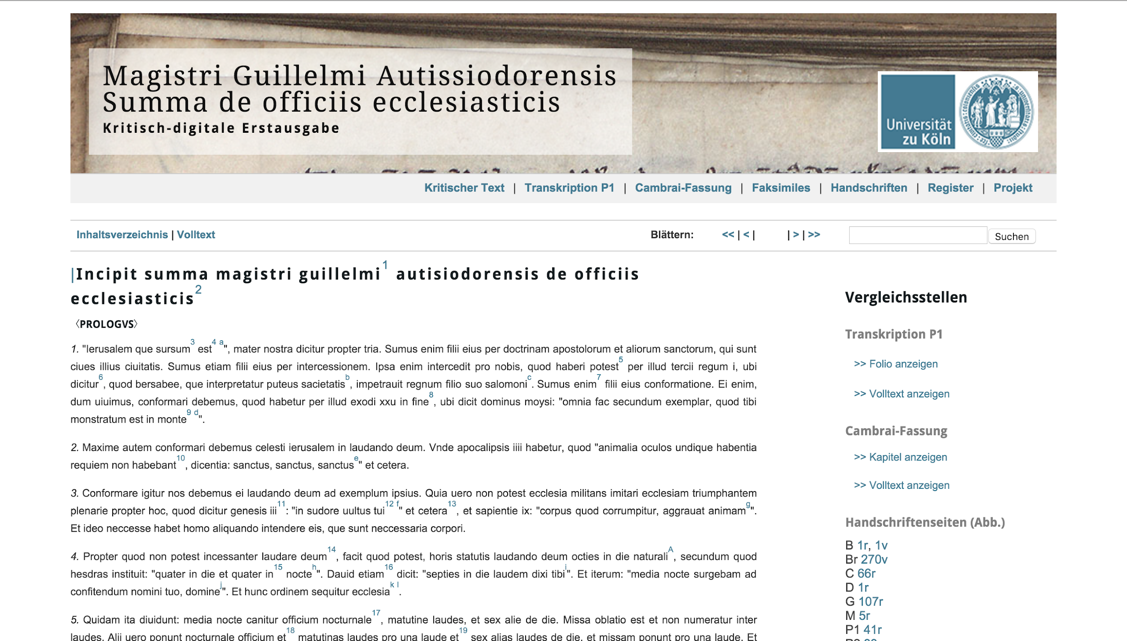
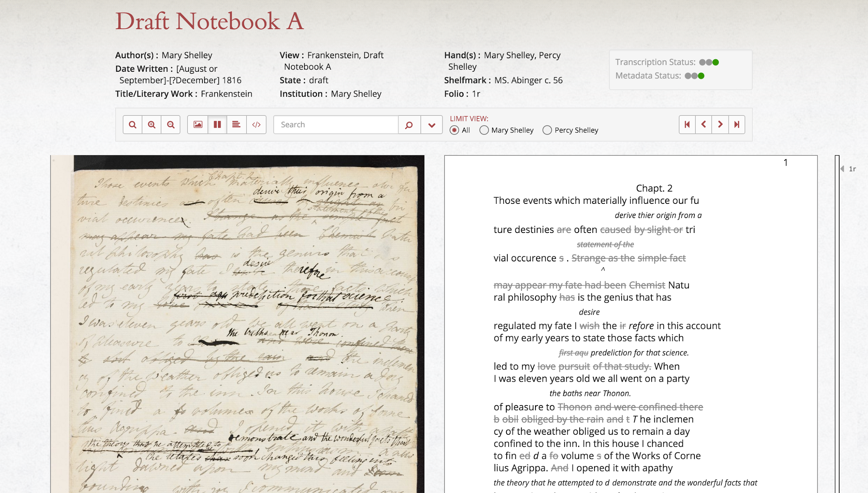

Slide 45
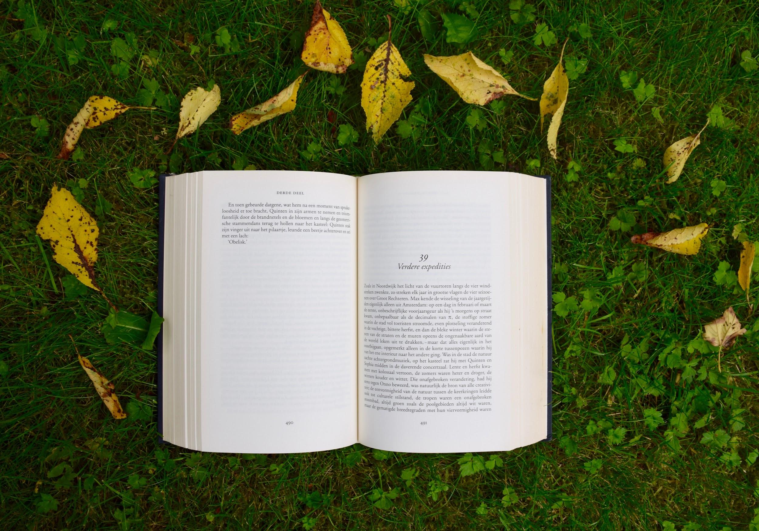

Slide 46
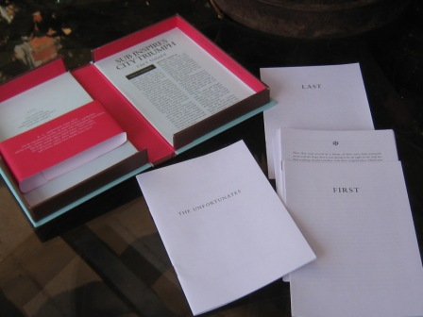
BS Johnson
The Unfortunates

Slide 47
The Digital Scholarly Edition
Hypertext is the combination of natural-language with the computer’s capacities for interactive, branching or dynamic display, when explicitly used as a medium. Or, to define it more broadly, ‘hypertext’ is the generic term for any text which cannot be printed (or printed conveniently) on a conventional page, or used conveniently when bound between conventional covers. ‘Non-linear text’ might be a fair approximation. (Nelson 1967, 195).

Slide 48
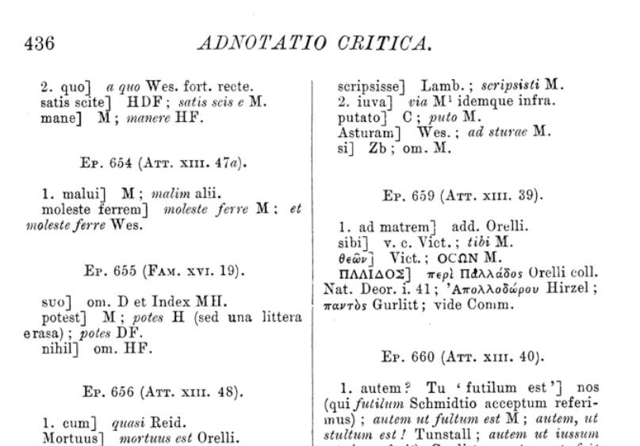

Slide 49
The Digital Scholarly Edition
Hypertext is the combination of natural-language with the computer’s capacities for interactive, branching or dynamic display, when explicitly used as a medium. Or, to define it more broadly, ‘hypertext’ is the generic term for any text which cannot be printed (or printed conveniently) on a conventional page, or used conveniently when bound between conventional covers. ‘Non-linear text’ might be a fair approximation.
Nelson 1967, 195

Slide 50
The Digital Scholarly Edition
Digital scholarly editions are not just scholarly editions in digital media. I distinguish between digital and digitized. A digitized print edition is not a ‘digital edition’ in the strict sense used here. A digital edition can not be printed without a loss of information and/or functionality. The digital edition is guided by a different paradigm. If the paradigm of an edition is limited to the two-dimensional space of the ‘page’ and to typographic means of information representation, than it’s not a digital edition.
Sahle 2008 (online)

Slide 51
The Digital Scholarly Edition
In other words: a Digital Scholarly Edition tries to take full advantage of the digital medium, e.g. by focussing on:
Providing an intuitive reading experience for comparing different versions
Satisfying the needs of different ‘schools’ of textual scholarship simultaneously (different visualizations on the basis of the same data)
Allowing the user to query the data in new user-friendly, flexible and unforeseen ways (GUI / API)
Engaging users to contribute to the edition’s content in new ways
Achieving new levels of accountability by encoding interpretative and editorial decisions on the micro level
…

Slide 52
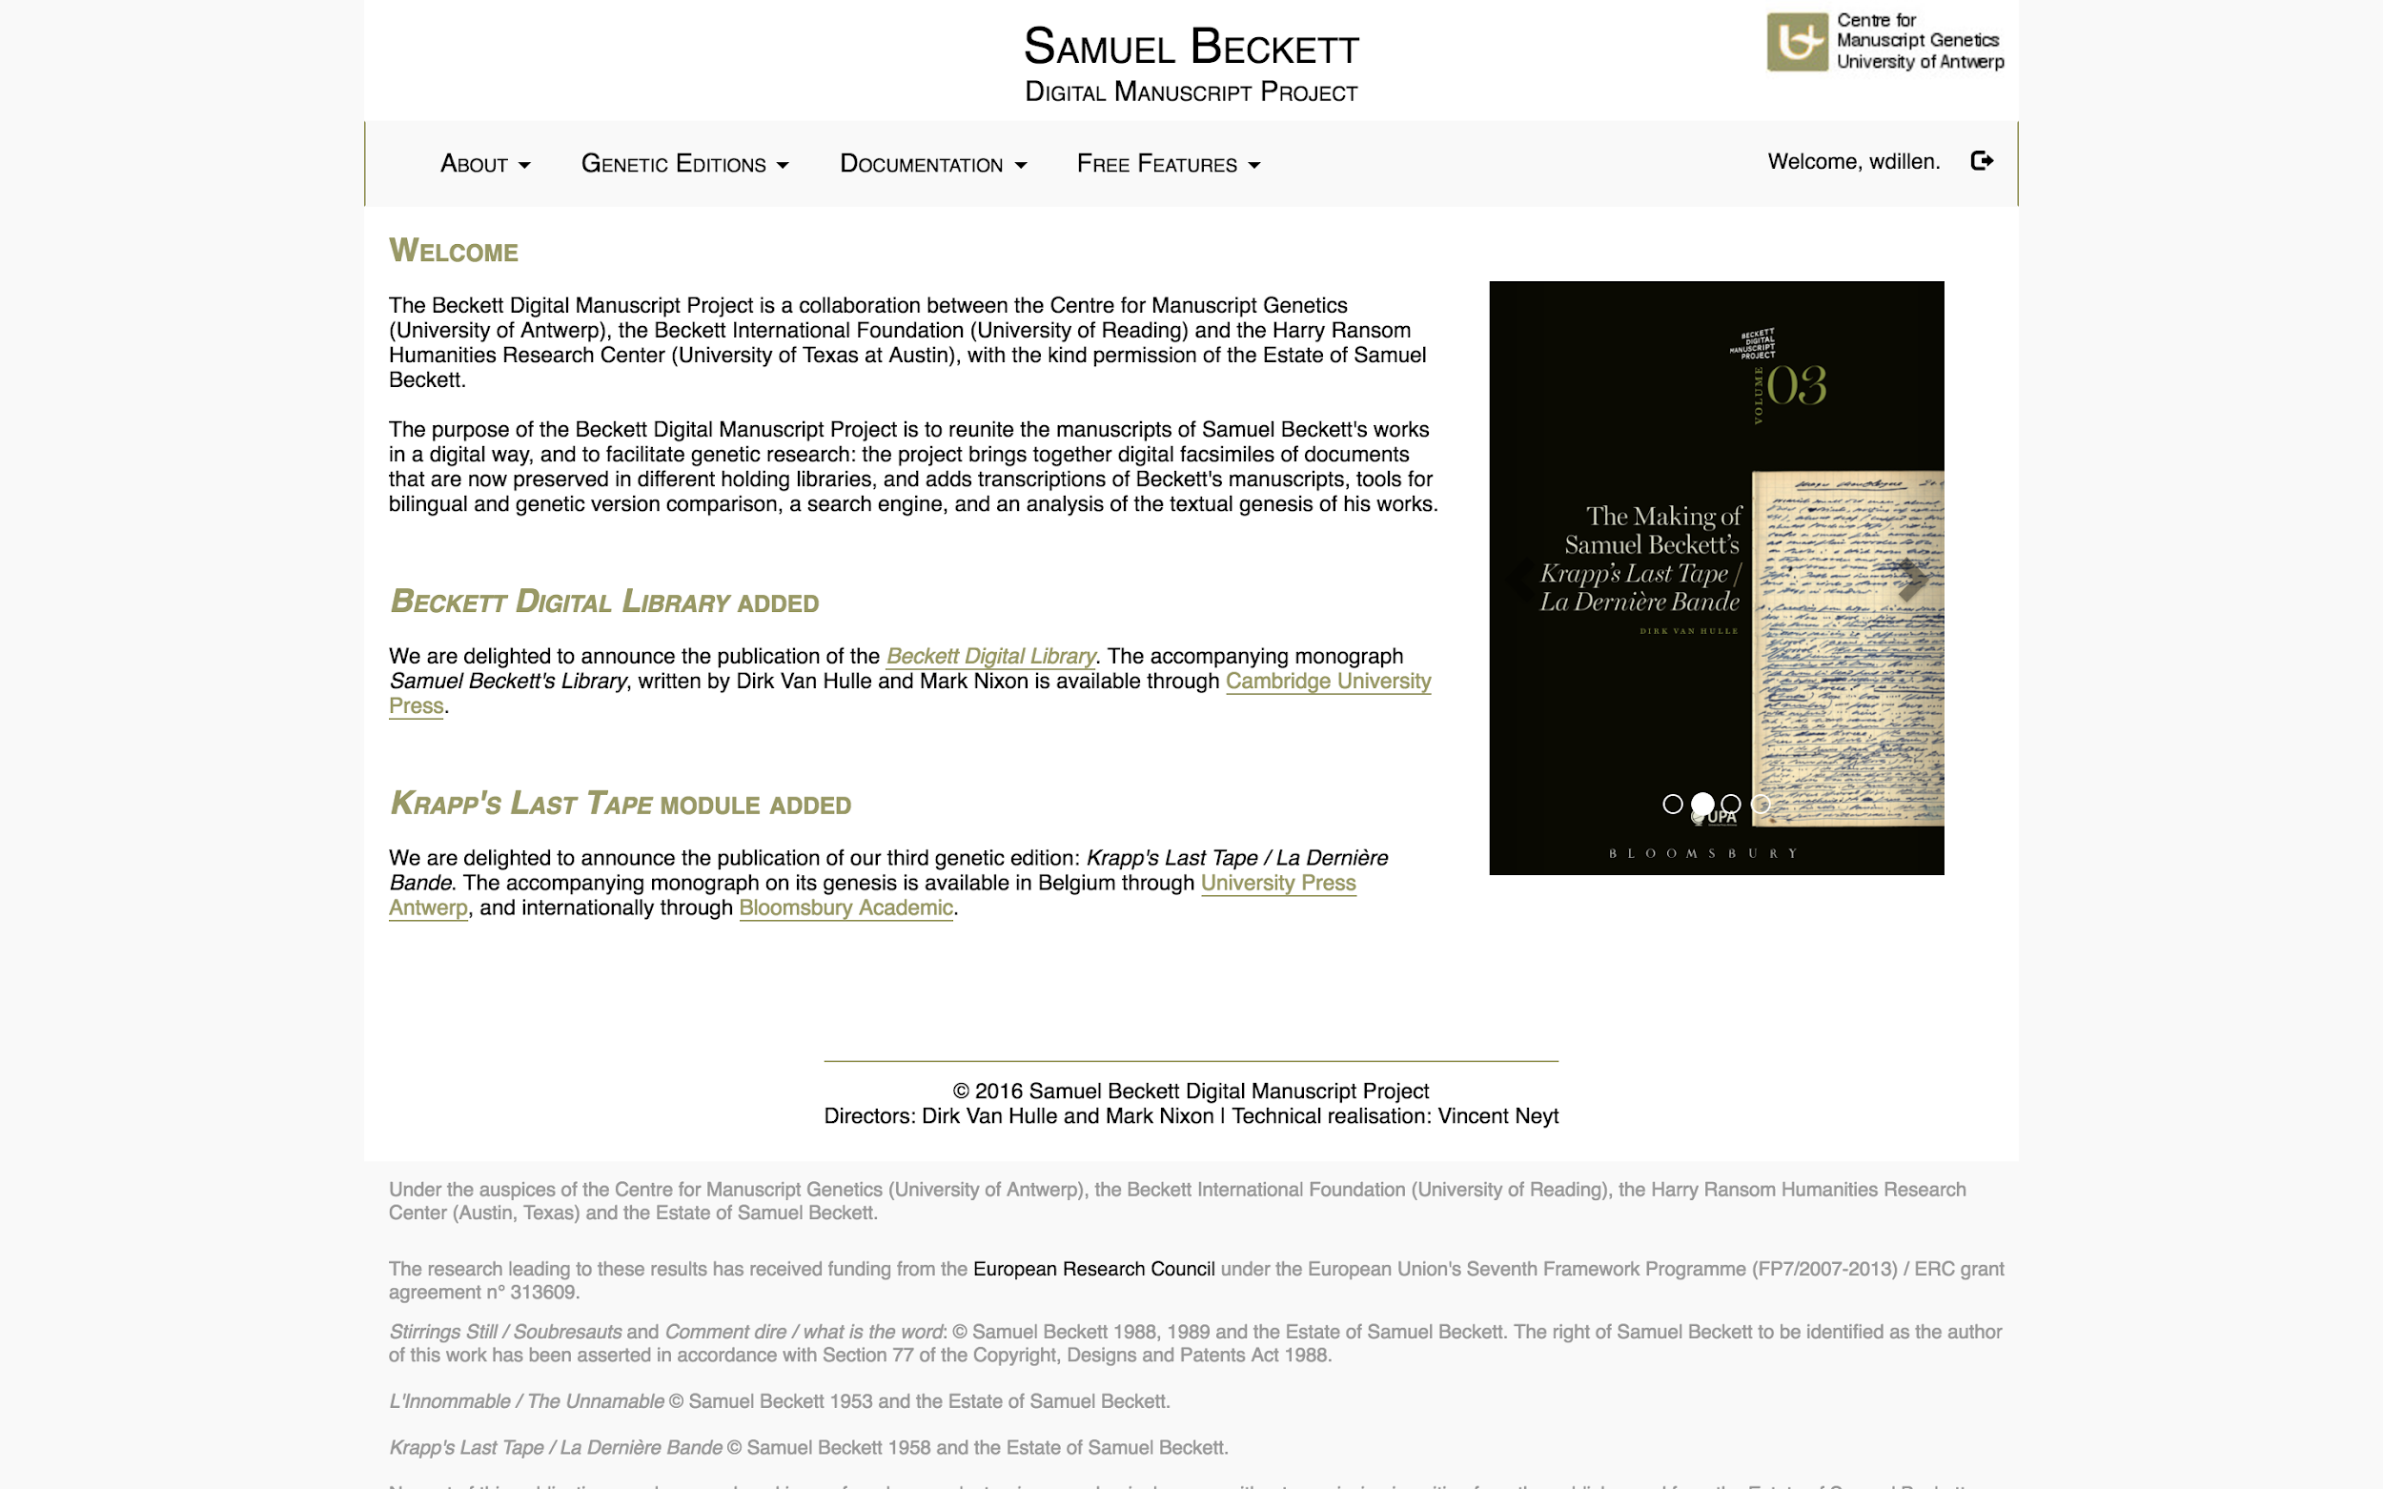
www.beckettarchive.org

Slide 53
More Quantitative Approaches

Slide 54
Distant Reading

Slide 55
Distant Reading
Distant Reading | Franco Moretti 2013:
>< “The very solemn treatment of a very few texts taken very seriously.”
Macroanalysis. Digital Methods & Literary History | Jockers 2013:
“Science has welcomed big data and scaled its methods accordingly. With a huge amount of digital-textual data, we must do the same. Close reading is not only impractical as a means of evidence gathering in the digital library, but big data render it totally inappropriate as a method of studying literary history.”

Slide 56

https://voyant-tools.org

Slide 57


Text Reuse Detection
Automatic detection intertextuality, plagiarism, etc.

Slide 58
Stylometry

Slide 59
Compression
Methods
Summarize series of identical symbols or patterns
AAAAAAA = 7*A
HAHAHAHAHA = 5*HA
“Dictionaries”
aan=1,he=2
het Spaanse graan heeft de orkaan doorstaan
2t Sp1se gr1 2eft de ork1 doorst1
Delta coding
4567,4570,4564,4565,...
4567,+3,-6,+1,...

Slide 60
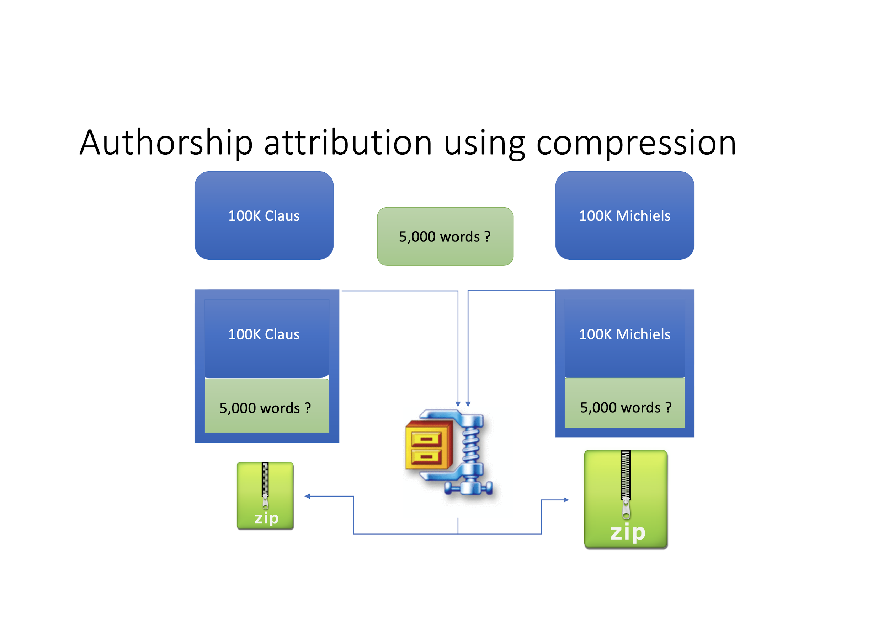

Slide 61
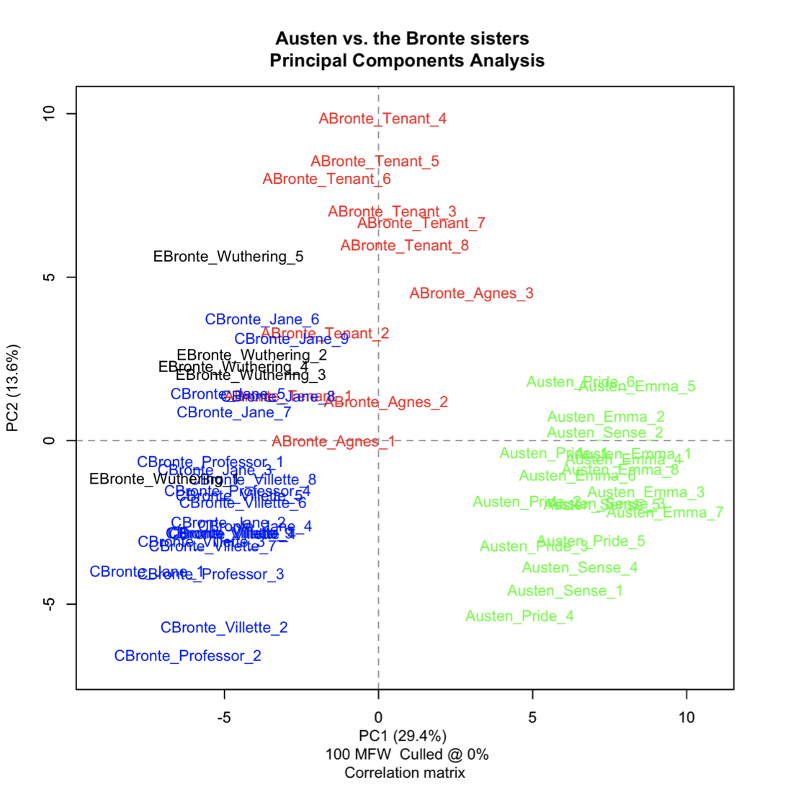
(Eder et al. 2016, 113)

Slide 62
Topic Modeling

Slide 63
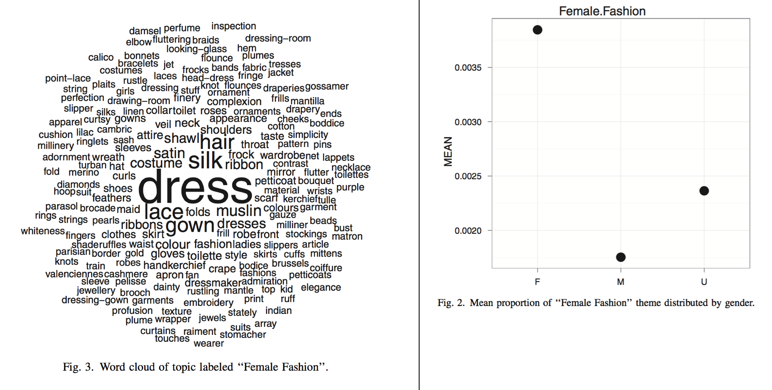
Digital Literary Studies

Slide 64
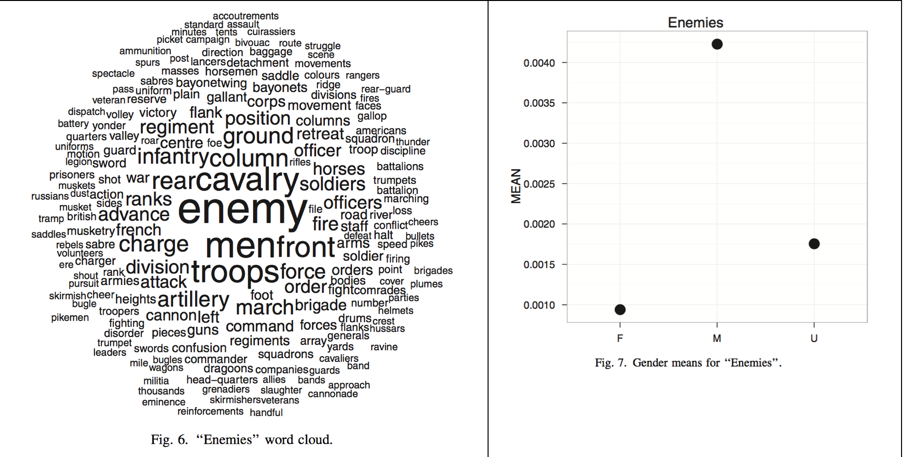
Digital Literary Studies

Slide 65
Conclusions

Slide 66
Digital Humanities and Objectivity
Tools and algorithms developed and used in Digital Humanities are rule based and have a foundation in mathematics.
Digital Humanities = Positivist Humanities?
YES: by automating processes and letting the computer draw conclusions, we are taking the researcher’s subjectivity out of the equation.
NO: the rules and calculations are all designed by humans, and are therefore problematic and with implicit bias. Critical understanding of the possibilities and limitations of the software is crucial. Subjectivity is limited but not erased, and (if not documented / justified) more dangerous because less obvious.

Slide 67
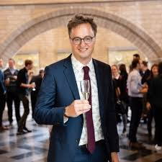
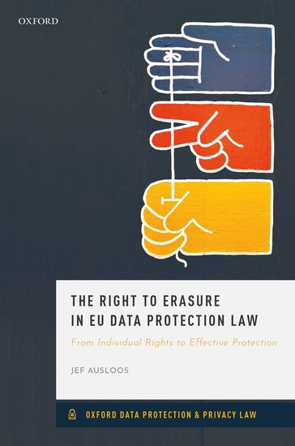

Friday Afternoon: Bias, Ethics, Privacy
Homework:
‘The End of Privacy as we Know It?’
10 Feb 2020, The New York Times
30 minute podcast from ‘The Daily’
Available from: https://nyti.ms/33fTv48
(Also available on: Spotify,
PocketCast, Apple Podcasts,
Google Podcasts, etc.)
Transcript also available via link above
Guest Speaker:
Jef Ausloos, University of Amsterdam

Slide 68
References
Eder, Maciej, Jan Rybicki, and Mike Kestemont. “Stylometry with R: A Package for Computational Text Analysis.” The R Journal 8, no. 1 (2016).
Jockers, Matthew L. Macroanalysis: Digital Methods and Literary History. University of Illinois Press, 2013.
Jockers, Matthew L., and David Mimno. “Significant Themes in 19th-Century Literature.” Poetics 41, no. 6 (2013): 750–769.
McCarty, Wilard. “Modeling: A Study in Words and Meanings.” In Companion to Digital Humanities (Blackwell Companions to Literature and Culture), edited by Susan Schreibman, Ray Siemens, and John Unsworth, Hardcover., 254–70. Blackwell Companions to Literature and Culture. Oxford: Blackwell Publishing Professional, 2004. http://www.digitalhumanities.org/companion/.
Minsky, Marvin. “Matter, Mind and Models,” March 1, 1965. https://dspace.mit.edu/handle/1721.1/6119.
Nelson, Theodor. “Getting It Out of Our System.” In Information Retrieval, A Critical Review, edited by George Schecter, 191–210. Washington: Thompson Books, 1967.
Sahle, Patrick. “A Catalog of Digital Scholarly Editions.” digitale edition, 2008. http://www.digitale-edition.de.

Slide 69
Credits & License
These slides were designed by Wout Dillen, as part of his class on ‘Concepts in Digital Literary Studies’, that was part of the Bootcamp course in the University of Antwerp’s MA in Digital Text Analysis at the Facultly of Arts. This class took place on Wednesday 30 September 2020. Wout currently works as a postdoctoral researcher at the University of Antwerp, where he coordinates the Antwerp part of the CLARIAH-VL project that has supported the work leading up to this class.
This work is licensed under a Creative Commons Attribution 4.0 International Public License. All works of other authors cited, linked, and referred to here are their intellectual property and are used for academic purposes only.

